Slide 1
CS299 INNOVATION LAB DOOR AUTOMTION SYSTEM PROJECT
Name:-Deepak kumar
Roll No.:-1901CS18
Branch:-CSE
Project Name:-Door automation system

Slide 2

What is door automation?
Door automation means door will automatically opened and closed via fingerprint , after sensor detection process , switch control etc. Door automation is allowing a standard hinged door, sliding door, pocket door, or double sliding door to operate automatically with a switch.
The automatic door opening systems are used in commercial buildings, shopping malls, theatres, etc. These systems are used to open the door when a person comes near to the entrance of the door and closes it after he moves away from the door or after entering into the door.

Slide 3
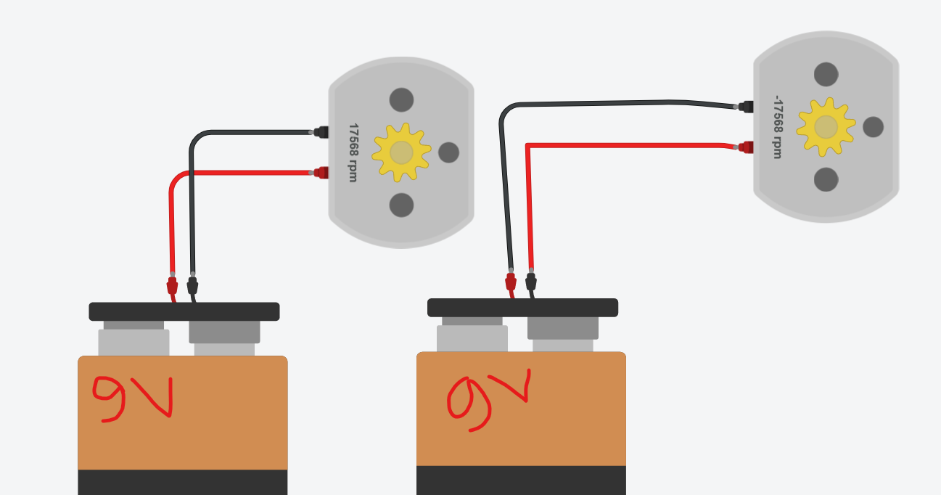
IDEA OF PROJECT:-
In this project door will automatically closed and opened (both process) done after detecting IR Sensor.
Working Rule 1:- In this working rule project Door will be only open and close in case of enter in the room.
Equipment used list:- Ir sensor,L239D motor driver, DVD loader,9 volt battery , battery cap, jumper wire.

Slide 4
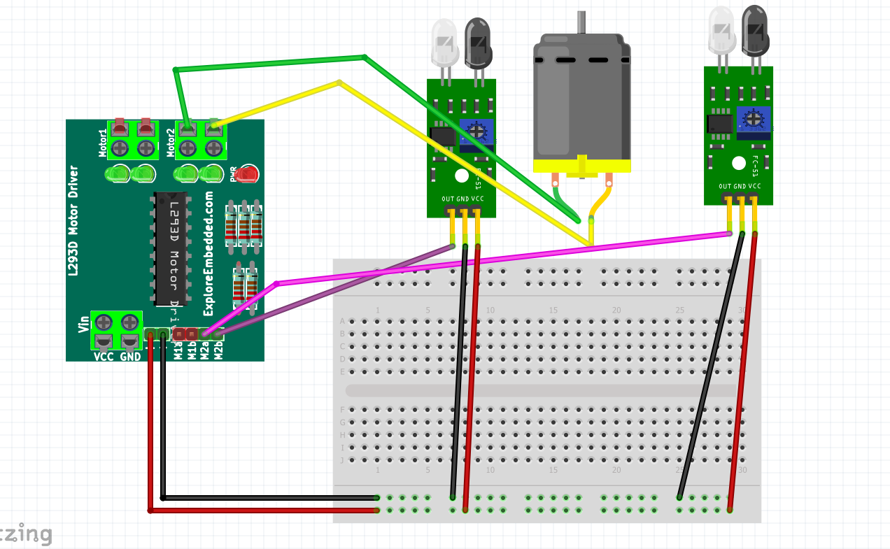
CIRCUIT DIAGRAM:-

Slide 5
DOOR AUTOMATION USING ARDUINO:-
Why Arduino is used in door automation ?
Working Rule 2:-
In previous working rule door will be closed and open in case of enter in the room ,so Arduino is used to remove problem (for coming out from room).if Arduino is used door will open and closed both cases(go inside and coming outside from room).
Equipment list:--Ir sensor, Arduino uno,L239D motor driver, DVD loader,9 volt battery , battery cap, jumper wire , Arduino power supply jack.

Slide 6
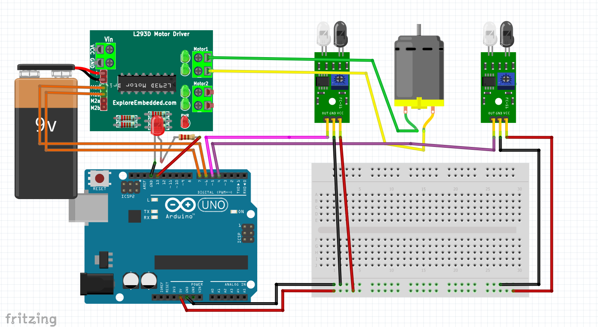
Circuit Diagram :-

Slide 7
PROJECT 2 **FINGER PRINT(MOBILE PHONE) LOCKING SYSTEM**
Idea of project:-I am using mobile phone fingerprint sensor to open a door using mit app inventor android app (This app is use to access enrolled fingerprint of mobile phones).person has to download this app and connect to bluetooth of mobile phone and then go to the app and click button to give fingerprint ,if fingerprint access granted door will automatically open(for 3 second and then closed) otherwise not open.
Component used list:-HC-05 Bluetooth module ,Arduino uno, dvd loader,9 volt battery,L293D motor driver and jumper wires,1 android phone.

Slide 8
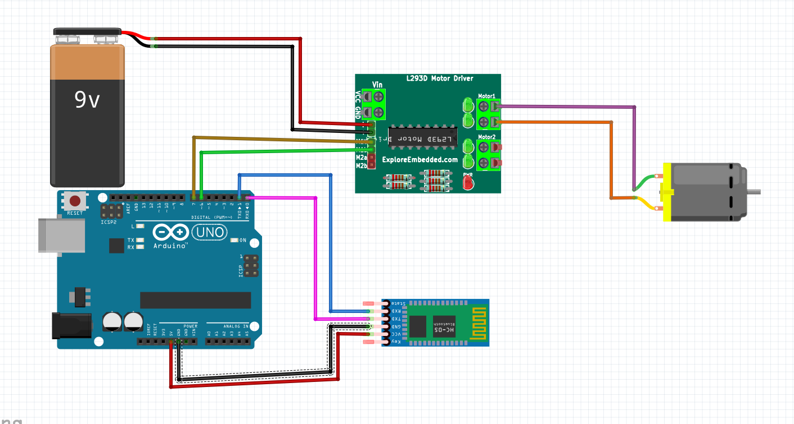
Circuit diagram:-

Slide 9
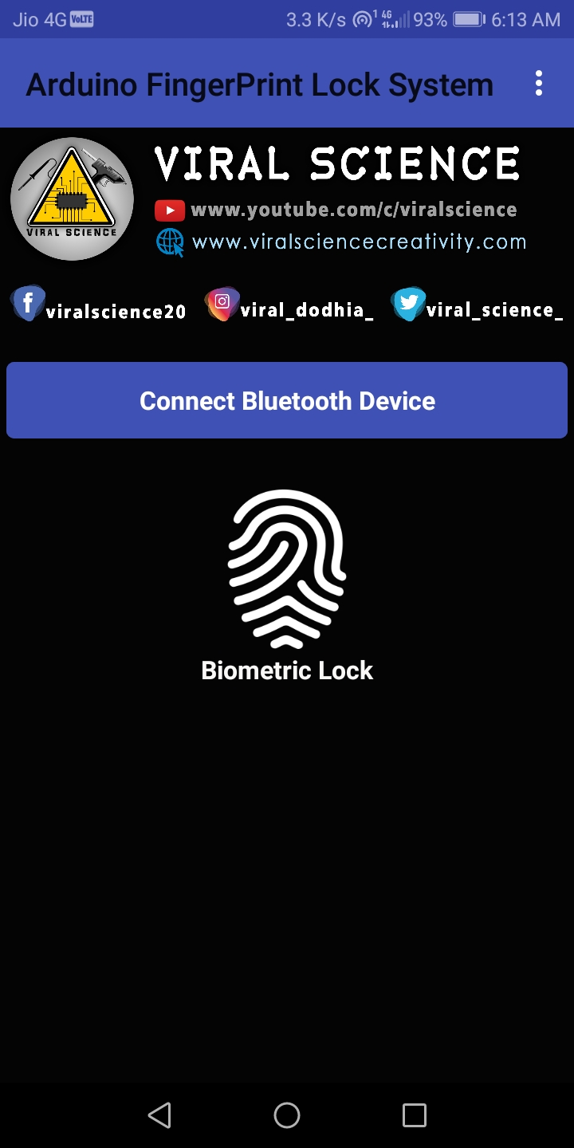
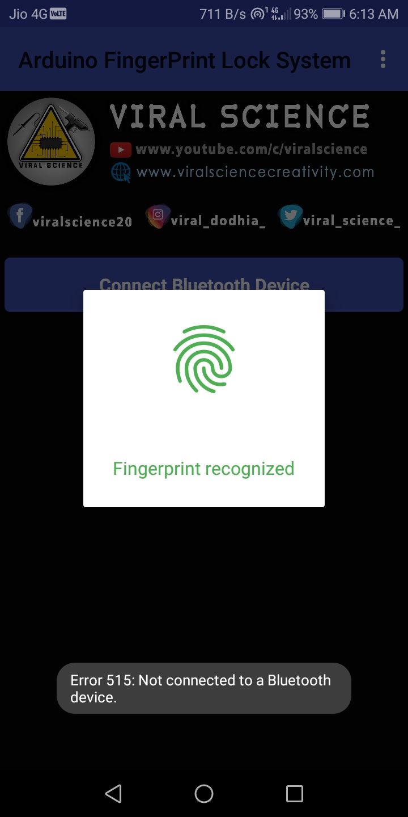
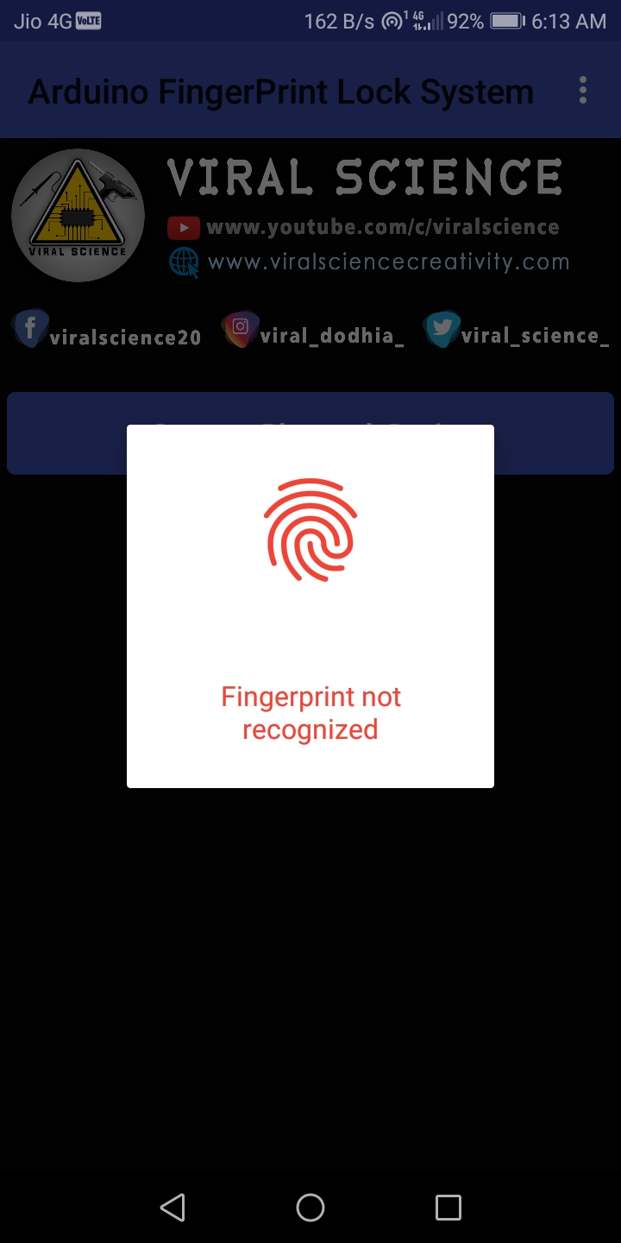
Mobile app use:-

Slide 10
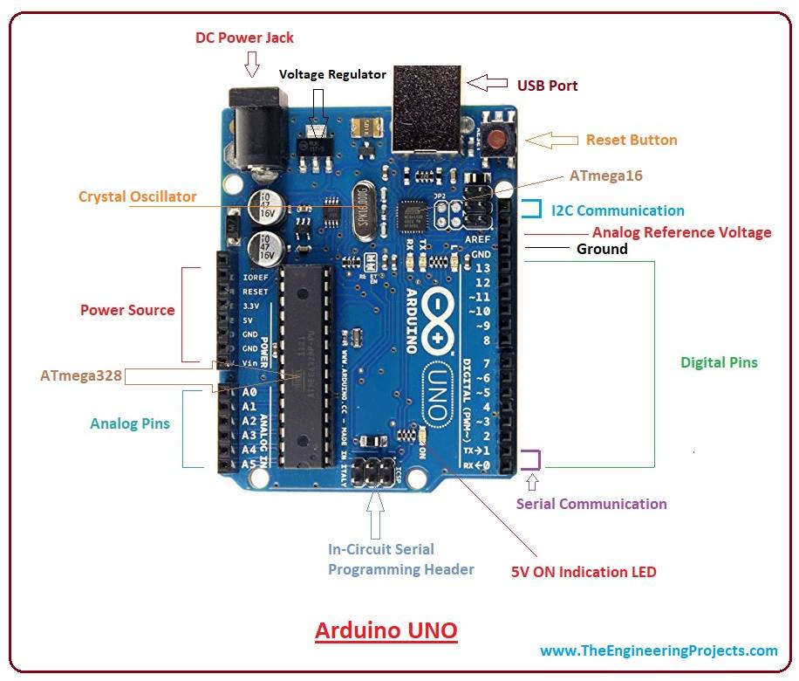
Description of Hardware part :-
ARDUINO UNO :-it is an open source physical computing platform for creating iterative object that stand alone or Collaborate with software on your computer.
In this project Arduino UNO acts as the main controlling part . It reads the data from the IR Sensor and activates the Motor Driver based on the data from the IR Sensor. And also reads the data send by mobile app for open and close the door via Bluetooth .
Arduino means three things :
A piece of hardware
A programming environment
Arduino ide

Slide 11
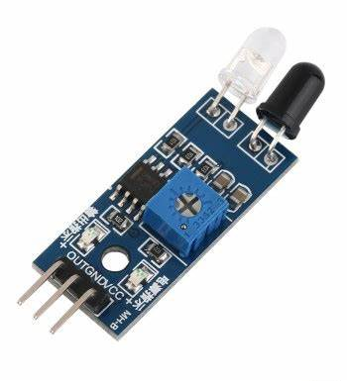
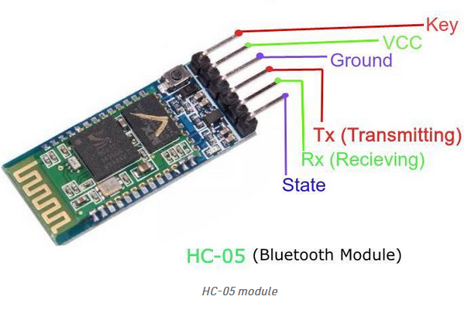
IR SENSOR:-
IR Sensor is use to detect any obstacle ,After detecting it’s send LOW signal into the Arduino.
HC-05 BLUETOOTH MODULE:- In this project it is used to read data from android app and send that data into the Arduino Uno.

Slide 12
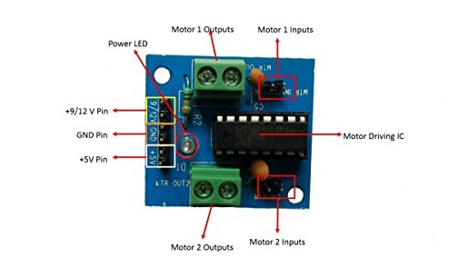
L293D MOTOR DRIVER:-
It is used to rotate motor anticlockwise or clockwise according to signal (HIGH, LOW) obtained by Arduino .
If signal obatained is ( HIGH, LOW)(in input pin) door will be open(clockwise motor rotate) and when obtained (LOW, HIGH) door will be closed(motor rotate anticlockwise).

Slide 13
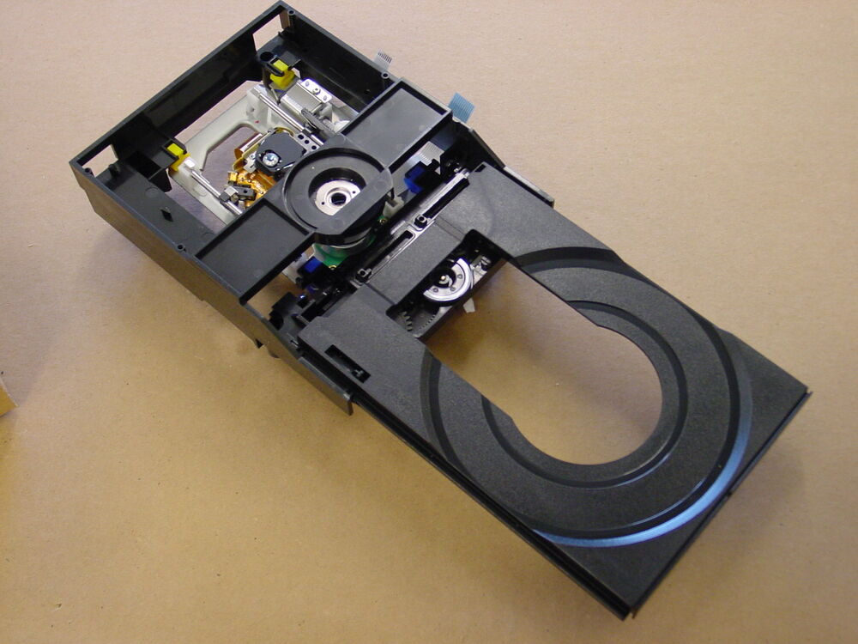
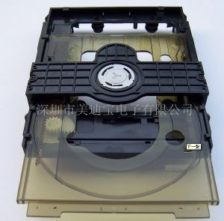
DVD LOADER:-
DVD loader is used as a Door .

Slide 14
ADVANTAGE:- IR sensor and Arduino:-
The automatic gate have no need any physical effort to open and close.
Automatic gates are durable , strong and can be available in customized sizes.
Easy to use.
Best for wheelchair based peoples
Fingerprint lock system:-
In this case of system security increase of the Room.
No need to take tension to keep safe key of the room .
DISADVANTAGE:- IR Sensor and Arduino:
Due to power failure inconvenience occur.
Can not use for security purpose.
It always consume power in case of no need to open or close.

Slide 15
CONCLUSION:-
This project is a simple design of automatic door opening and closing system where IR sensor and Fingerprint sensor serve the main input function and here Arduino uno is microcontroller board . We can conclude that this is a simple and low cost architecture of automatic door opening system but having lots of benefit such as we can conserve energy ,reduce human efforts , save time etc . Arduino based Automatic Door opener system is a very useful project s t enables you to understand the concept of such automatic door system and how they work . These system are already being used in many places like malls, theatres, and hospitals.
THANK YOU

